Slide 1





by
Shadi Jiha
Christina Darstbanian
Magic Voice App

Slide 2
Application: Voice Enabled App
Main Problem:
Creating an application that allows users to navigate the application, fill forms and read content via voice instructions
Objective :
Help Users navigate Easily Through Voice instructions
Let Users create posts and fill forms

Slide 3
Talking Business!
Voice technologies are still relatively ne
Lots of investments in that sector
Voice driven apps help in lots of ways. Example: blind people
Notes:
* Lots of money to be made in that sector

Slide 4
Main Approach
User database with credentials
Access to their account after login or register
Navigation and completing many functionalities by speech recognition technology.
User friendly voice commands.

Slide 5
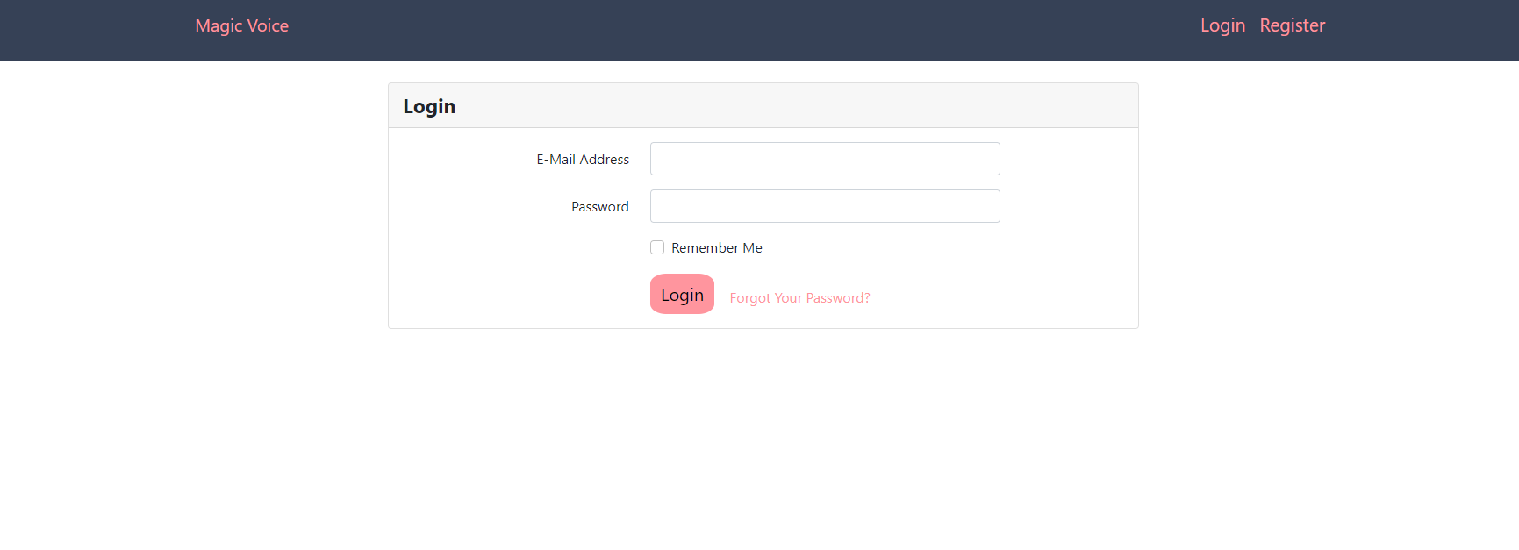
User Friendly Design
Easy Transmission between parts of the application
Error feedback

Slide 6
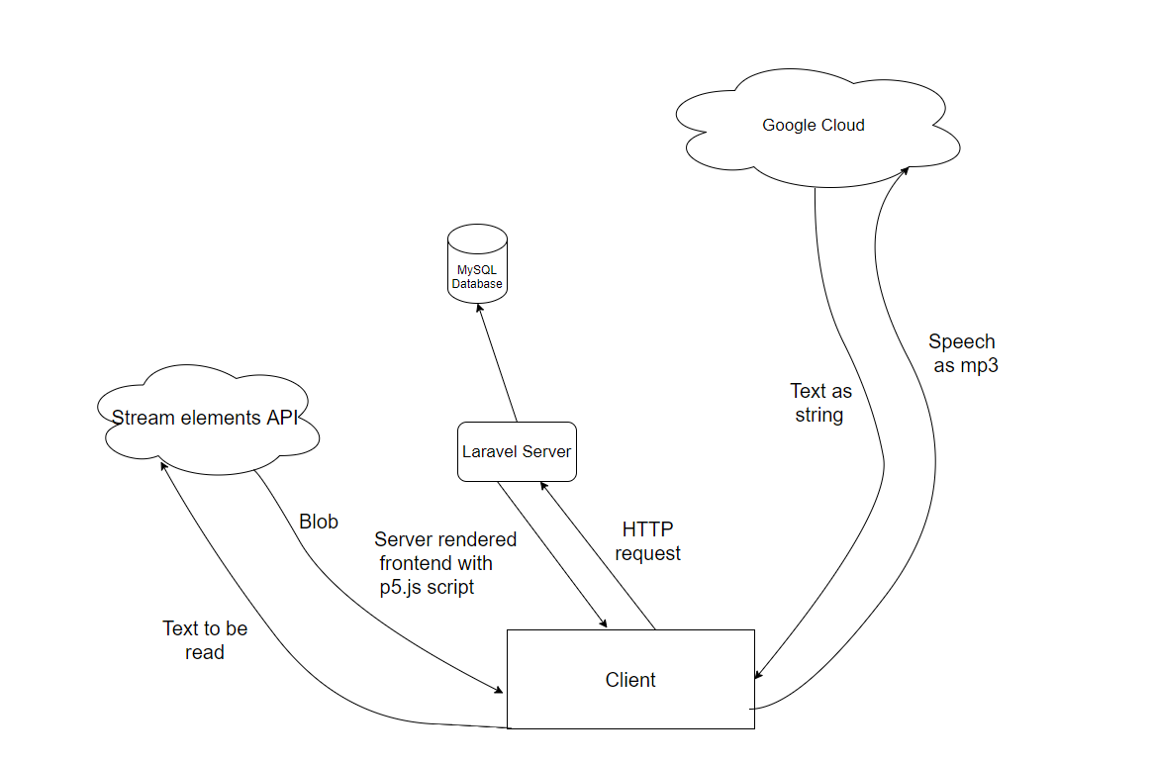
Speech recognition with P5.Js
How it works?

Slide 7
Technologies Used:
Speech recognition(P5.Js)
PHP Laravel
Composer and NPM
MySQL
Blade
JavaScript
Bootstrap
Not ideal by OK for proof of concept given the time frame

Slide 8
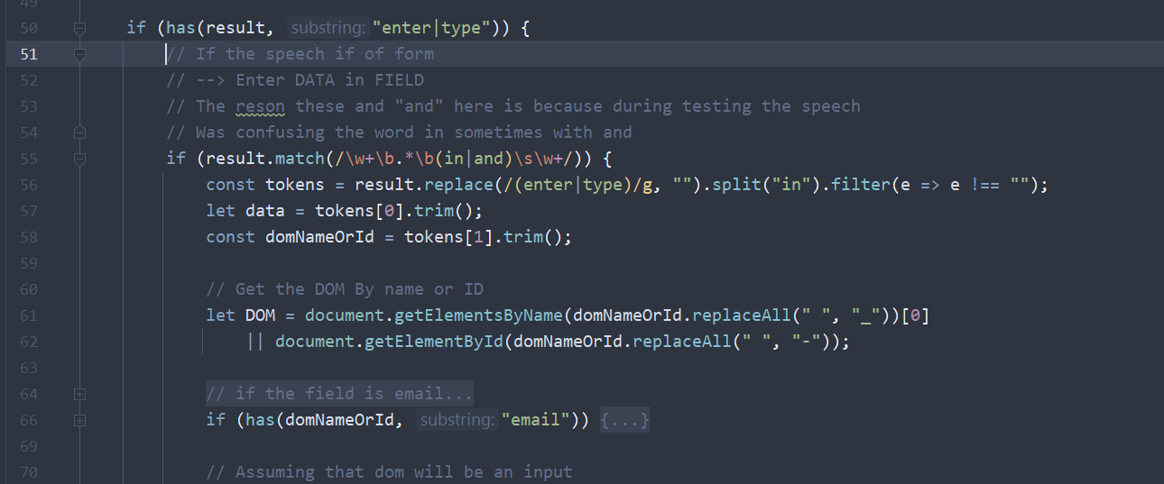
Wrong text recognition
This happens on the usage of similar pronunciation words (such as “test” and “text” ). The voice recognizer gets confused.

Slide 9
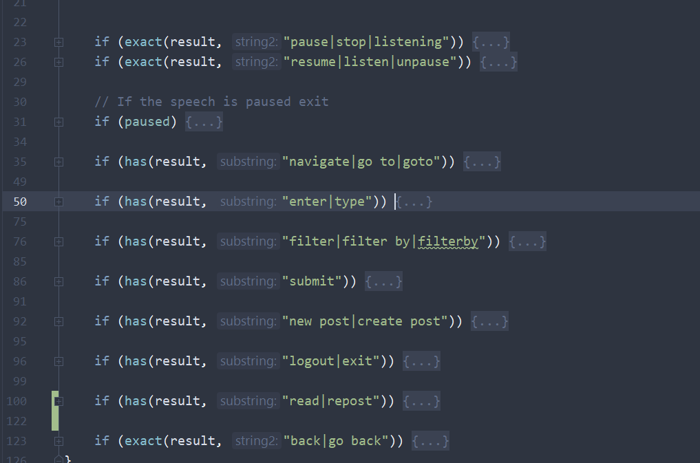
Multiple choice
Each user gives different command structure.
Solution: Added multiple choice. E.g. line 92

Slide 10
E-mail problems
Problems when user wants to enter his email (at keyword)
When user says: “Enter X@Y.com in email”. The speech would yield “x at y dot com”
So additional logic was necessary.

Slide 11
Finding the right API for TTS
Challenges encountered
Cost
Request limit
Stream elements:
Free
Enough requests per minute
Notes:
* Hard to find correct choice API for text-to-speech

Slide 12
Extendibility
Given the timeframe. Very hard for API design
The purpose was to demonstrate that voice command are possible (proof of concept)
HOWEVER! Can refactor and use callbacks
Notes:
* it was really hard to design a full extendable and maintainable system that would work on any application.
*
* It is easy to refactor the code to use some sort of Callback system. Which allows each application to define

Slide 13
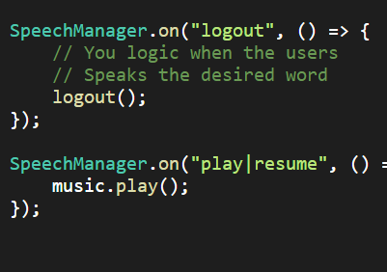
A peek of future API
The future API using callbacks can look like this
What we did was a prove of concept and can be transformed to a library

Slide 14
If the App was to be redone
What technologies would I use instead and why (After app demo)

Slide 15
Finally
Shadi Jiha: (contact: shadijiha@gmail.com)
professional experience
Social media manager at Bijouterie Hamel (2 years)
Full stack intern at TapMedical Montreal (1 year)
Personal projects
Web dev: Made my own simpler version of “Google drive” (upload, create files) on my own Linux server.
C++: Graphics with OpenGL (sort of a game engine)
Java/C#: Created my own Compiler (my costume programming language)
JS/TS: Created my own code editor
Familiar with other languages although no significant projects

